Slide 1
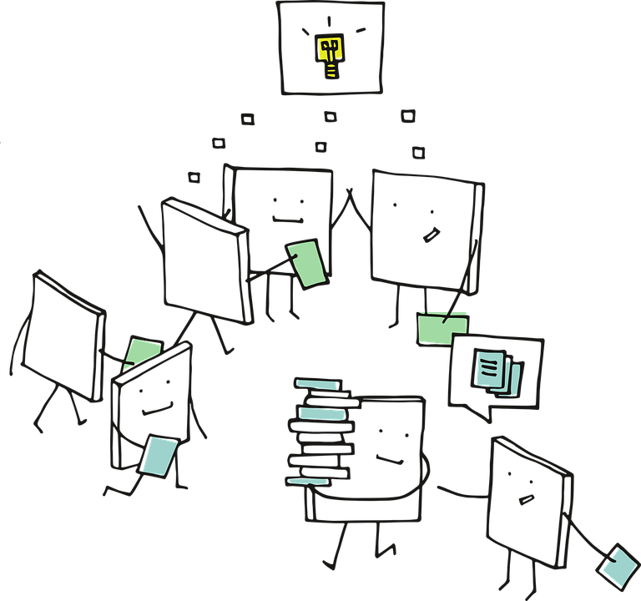
Advanced Computer Vision

Slide 2
Convolutional Neural Network (CNN)
Transfer Learning
CNN Architectures
Concepts that we have learned so far (or should be familiar before proceeding further)

Slide 3
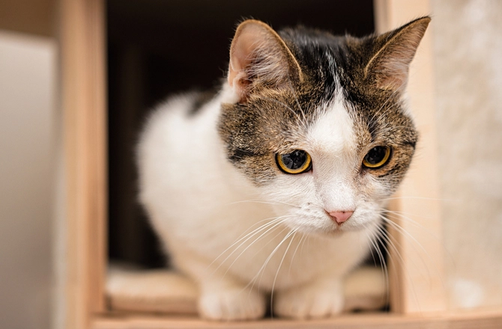
Cat 0.9
CNN
e.g. VGG, AlexNet
Dog 0.05
. . .
Bird 0.03
Elephant 0.01
So far our work in Computer vision has involved telling what is there in the picture?

Slide 4
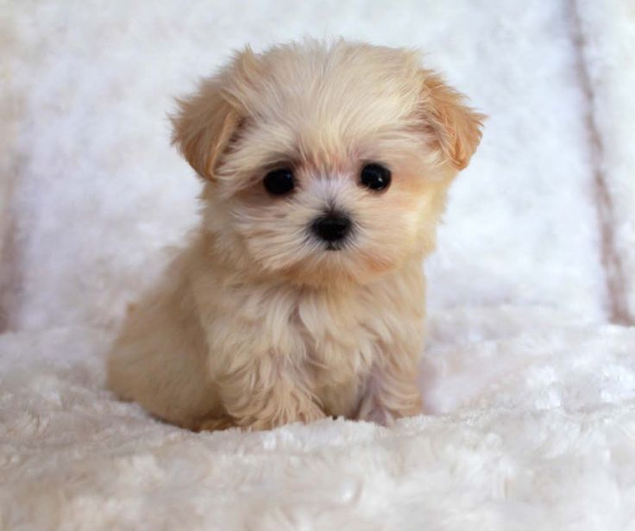
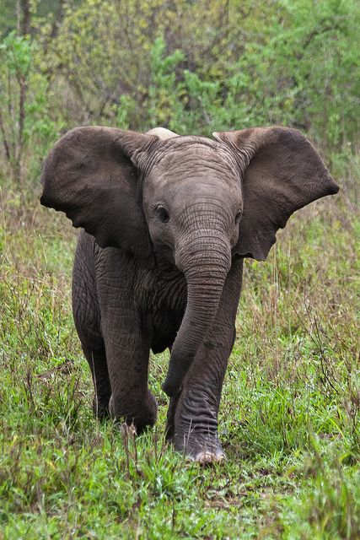
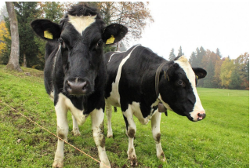
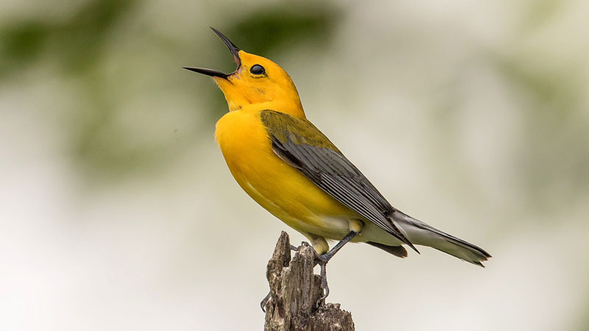
For lots of different images

Slide 5

Deeper into Computer Vision

Slide 6
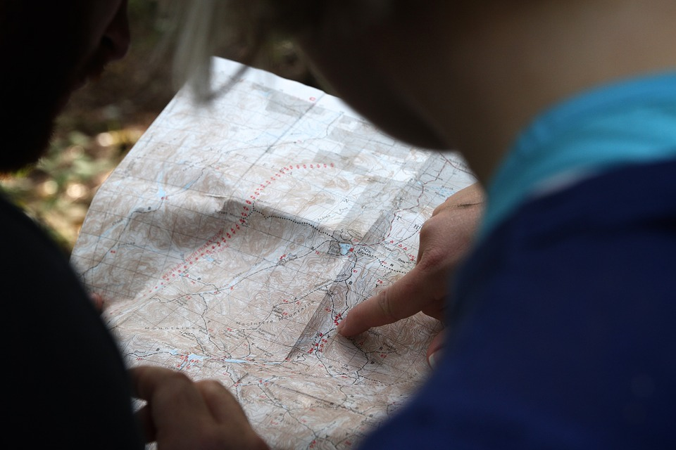
Where is the object in picture?

Slide 7
Applications of Computer Vision using ‘Where’

Slide 8
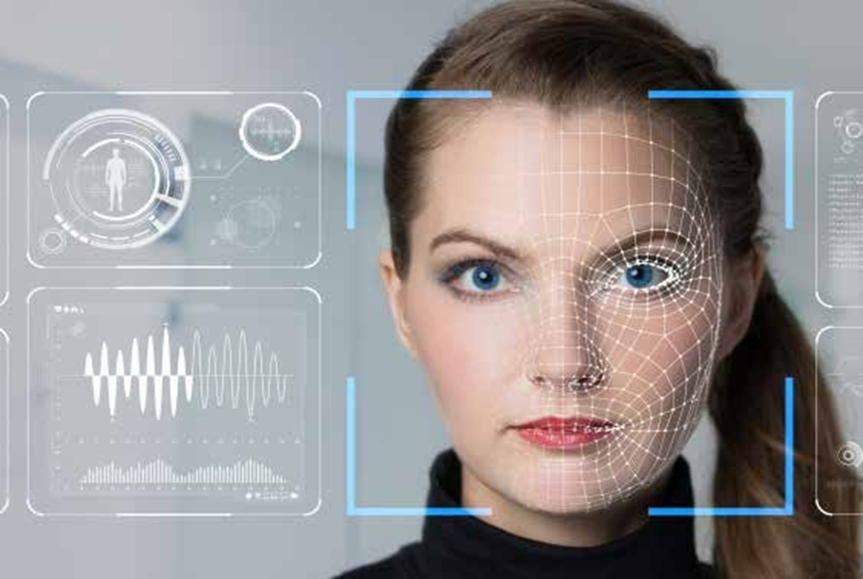
Face Detection

Slide 9
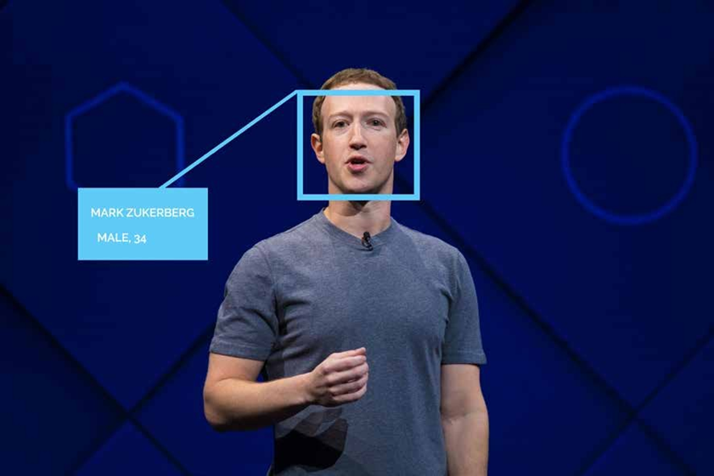
Face Recognition
Emotion Detection
Gender Detection

Slide 10
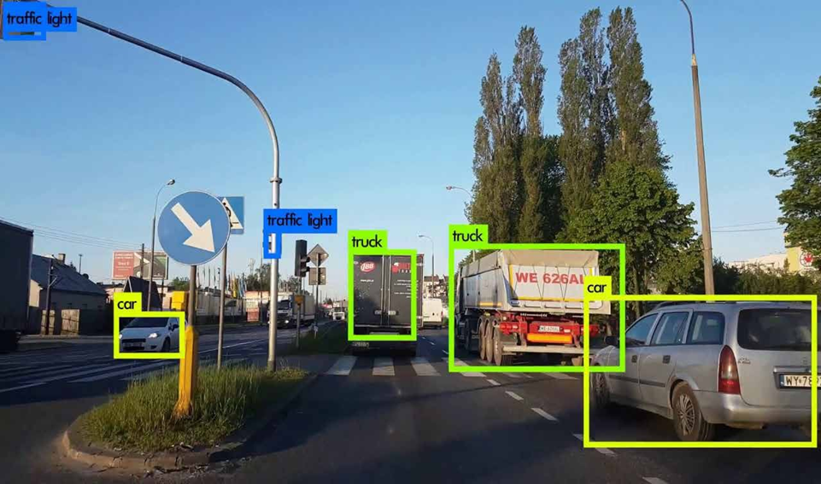
Vehicle Detection

Slide 11
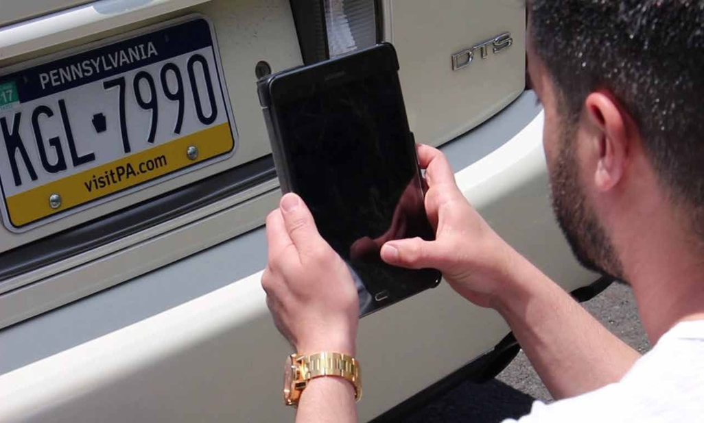
Optical Character Recognition
Automatic Number Plate recognition

Slide 12
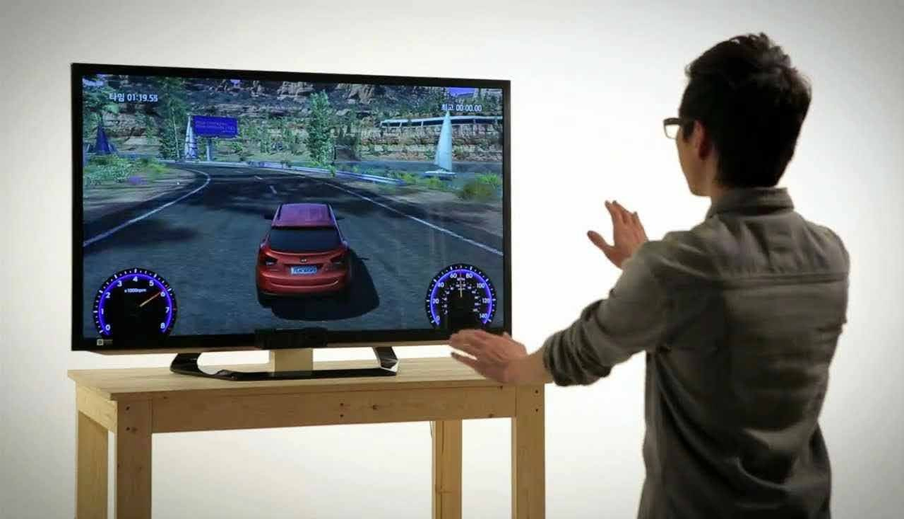
Gesture Recognition

Slide 13
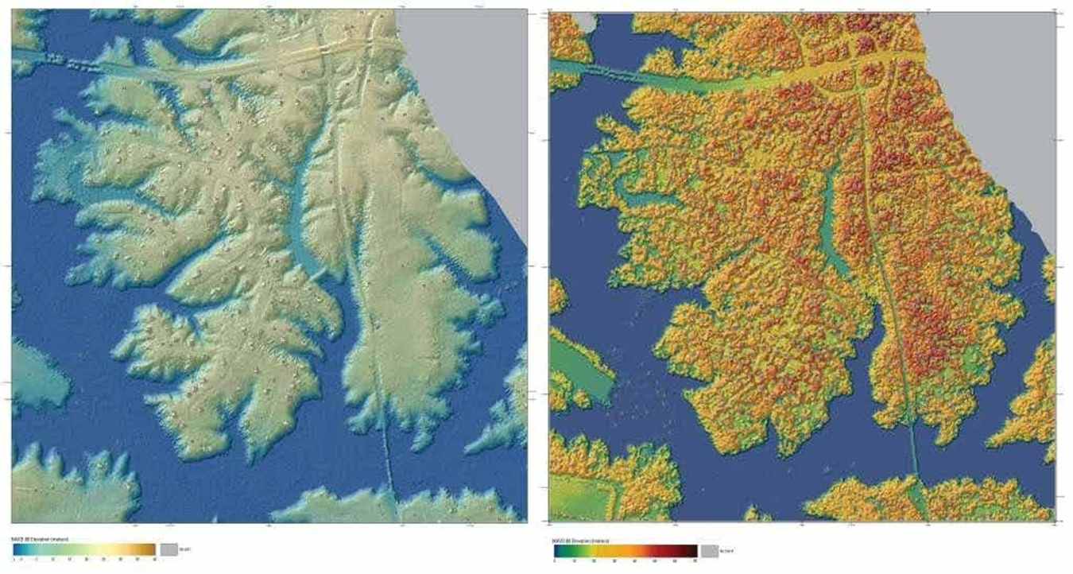
Remote sensing

Slide 14
1
Object Localization
2
Object Detection
3
Semantic
Segmentation
4
Instance Segmentation
5
Siamese Network

